Slide 1
Representing, Reporting and Presenting Findings
Clark Jaenichen, Sharvil Shastri, Raquel Palomo, Angela Tseng, Sandy Staub, Vijay Arni, Paula Montero Atienza

Slide 2
CONTENTS:
Representing insights and deliverables
Representing People: Personas
Representing situations: Scenarios
Representing Activities and Processes
Representing Systems: Experience Models
Informal reporting
Preparing and presenting formal reports
The presentations
The workshops
Extending the reach of research
conclusion

Slide 3
Representing insights as deliverables
Successful handoff of user research is crucial for achieving its intended impact
Challenges in handoff include disagreements about research implications, difficulty in committing to action, and conflicting stakeholder views
Research findings should be presented in a way that meets stakeholders' needs, including personas, scenarios, task analysis diagrams, and experience models
The goal is for stakeholders to remember the story, problems, and opportunities revealed by the research, and take action to address them.

Slide 4

Representing People: Personas
As described in 2005 by designer Kim Goodwin, “A persona is a user archetype you can use to help guide decisions about product features, navigation, interactions, and even visual design.”
This “archetype” is not real people but a synthesis of facts and observations about real users that leads to a memorable character.
Personas are valuable tools for product design and development.
Personas represent goals and behavior patterns, not demographic attributes or job responsibilities, and can assist design in serving as a shared reference point.
The success of personas depends largely on how well their creators can ground them in data and integrate them into an organizational culture.

Slide 5
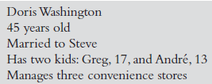

How to research for personas
Research for personas
Talk to people who work directly with the product as well as those responsible for expanding the audience or entering new markets
Utilize existing sources of information about users, such as demographic profiles and market research, as well as customer forums and community sites.
Analyze data to extract common threads and important ways in which users vary.
Prioritize attributes and patterns.
Define your persona draw upon the personal details and anecdotes you observed in your research to synthesize realistic people from the clusters of attributes.

Slide 6
Representing Situations: Scenarios
What are “Scenarios”?
Scenarios are “stories” that describe a how a person behaves or thinks about an activity or a situation.
Used to communicate the subtleties and nitty gritty of using the product and help stakeholders observe the product in context of people’s lives.
Two types:
Context or Problem scenarios - describe the current state of affairs
Design scenarios - envision proposals for change
Notes:
Designing tools means understanding people’s goals and the exact steps they take to accomplish them
How critical is a task to accomplishing the goal? How often is it performed? What is the order of actions? What are the tools involved? Where do problems typically occur? Where is there flexibility in the process? What decisions must be made, and who makes them? What kinds of resources, informational and otherwise, do people need and use at various points in the process?
Task analysis
Personas portray characters, and scenarios tell stories. In contrast, a task analysis details sequences of actions taken by an individual person.
best used when you already know what problem you’re trying to solve but you don’t know how people are solving it right now
It can help diagnose potential usability pain points, establish system dependencies, or identify new product development opportunities in areas where people lack the tools they need to accomplish their goals.
Task analysis is also best used for goal-directed, well-bounded procedures, such as buying furniture.
Activities with no clear criteria for success and no defined sequences of steps are not likely to be amenable to decomposition.
qualitative methods such as interviews and field visits; combination since participants are more likely to tell you how a task is supposed to be done rather than what they are actually doing
Using stakeholder interviews (described in Chapter 4), decide how detailed your task analysis needs to be to support the needs of design and development through the next major product development cycle. It can be helpful to create a template or example ahead of time to help you figure out when you’ve provided enough detail.
Questions at these interviews should be geared toward understanding how the participant performs the task at hand.
Analyzing the data
Task decomposition
Describe the actions and do error projection to see what would happen if the action weren’t performed
Hierarchical task analysis
HTA maps out the relationships between steps by putting them into groups, then indicating how the individual steps and groups are connected.
Resembles a flowchart
If you’re mostly interested in how the components of a task fit together (for example, if you’re looking for where a tool can optimize a task’s speed), then start with HTA and flesh out key details with decomposition. If you’re interested in making a tool that fits with existing practice, then start with decomposition as a way to understand inputs and outputs, and then quickly sketch out the progress of the task in hierarchical form.
Representing tasks
Flowchart diagrams
Grids
Towers
Maps

Slide 7
Representing Situations: Scenarios
When to use these scenarios?
How to make scenarios?
Context scenarios are used in early stages of design.
Design scenarios come into play throughout design and development
Context scenarios are frequently paired with design scenarios to demonstrate how a design response might improve upon the current state of affairs
Created by storytelling, either with personas we create or by directly drawing from stories we hear in our research
Only relevant stories are appropriate to make scenarios useful
Activities to include in scenarios:
Most frequently taken to achieve them
Those necessary to achieve it
Those that take place as a part of single sequence
Notes:
Designing tools means understanding people’s goals and the exact steps they take to accomplish them
How critical is a task to accomplishing the goal? How often is it performed? What is the order of actions? What are the tools involved? Where do problems typically occur? Where is there flexibility in the process? What decisions must be made, and who makes them? What kinds of resources, informational and otherwise, do people need and use at various points in the process?
Task analysis
Personas portray characters, and scenarios tell stories. In contrast, a task analysis details sequences of actions taken by an individual person.
best used when you already know what problem you’re trying to solve but you don’t know how people are solving it right now
It can help diagnose potential usability pain points, establish system dependencies, or identify new product development opportunities in areas where people lack the tools they need to accomplish their goals.
Task analysis is also best used for goal-directed, well-bounded procedures, such as buying furniture.
Activities with no clear criteria for success and no defined sequences of steps are not likely to be amenable to decomposition.
qualitative methods such as interviews and field visits; combination since participants are more likely to tell you how a task is supposed to be done rather than what they are actually doing
Using stakeholder interviews (described in Chapter 4), decide how detailed your task analysis needs to be to support the needs of design and development through the next major product development cycle. It can be helpful to create a template or example ahead of time to help you figure out when you’ve provided enough detail.
Questions at these interviews should be geared toward understanding how the participant performs the task at hand.
Analyzing the data
Task decomposition
Describe the actions and do error projection to see what would happen if the action weren’t performed
Hierarchical task analysis
HTA maps out the relationships between steps by putting them into groups, then indicating how the individual steps and groups are connected.
Resembles a flowchart
If you’re mostly interested in how the components of a task fit together (for example, if you’re looking for where a tool can optimize a task’s speed), then start with HTA and flesh out key details with decomposition. If you’re interested in making a tool that fits with existing practice, then start with decomposition as a way to understand inputs and outputs, and then quickly sketch out the progress of the task in hierarchical form.
Representing tasks
Flowchart diagrams
Grids
Towers
Maps

Slide 8
Representing Situations: Scenarios
Writing a scenario
Communicating Scenarios
Introspect situations you recall from encounters with potential users & imagine how they would react to personas
Introduce constraints one at a time to observe how a story changes
Note major departures from stories and validate assumptions. They should stay high-level and not dwell on interface elements
Most convenient way is in writing
To get more specific, photographs representing key moments in the scenarios can be used
Notes:
Designing tools means understanding people’s goals and the exact steps they take to accomplish them
How critical is a task to accomplishing the goal? How often is it performed? What is the order of actions? What are the tools involved? Where do problems typically occur? Where is there flexibility in the process? What decisions must be made, and who makes them? What kinds of resources, informational and otherwise, do people need and use at various points in the process?
Task analysis
Personas portray characters, and scenarios tell stories. In contrast, a task analysis details sequences of actions taken by an individual person.
best used when you already know what problem you’re trying to solve but you don’t know how people are solving it right now
It can help diagnose potential usability pain points, establish system dependencies, or identify new product development opportunities in areas where people lack the tools they need to accomplish their goals.
Task analysis is also best used for goal-directed, well-bounded procedures, such as buying furniture.
Activities with no clear criteria for success and no defined sequences of steps are not likely to be amenable to decomposition.
qualitative methods such as interviews and field visits; combination since participants are more likely to tell you how a task is supposed to be done rather than what they are actually doing
Analyzing the data
Task decomposition
Describe the actions and do error projection to see what would happen if the action weren’t performed
Hierarchical task analysis
HTA maps out the relationships between steps by putting them into groups, then indicating how the individual steps and groups are connected.
Resembles a flowchart
If you’re mostly interested in how the components of a task fit together (for example, if you’re looking for where a tool can optimize a task’s speed), then start with HTA and flesh out key details with decomposition. If you’re interested in making a tool that fits with existing practice, then start with decomposition as a way to understand inputs and outputs, and then quickly sketch out the progress of the task in hierarchical form.
Representing tasks
Flowchart diagrams
Grids
Towers
Maps

Slide 9
Representing Activities and Processes
Task analysis is best used on goal-directed, well-bounded procedures
Analyzing the data
Task decomposition
Hierarchical task analysis
Representing tasks
Flowchart diagrams
Grids
Towers
Maps
Notes:
Designing tools means understanding people’s goals and the exact steps they take to accomplish them
How critical is a task to accomplishing the goal? How often is it performed? What is the order of actions? What are the tools involved? Where do problems typically occur? Where is there flexibility in the process? What decisions must be made, and who makes them? What kinds of resources, informational and otherwise, do people need and use at various points in the process?
Task analysis
Personas portray characters, and scenarios tell stories. In contrast, a task analysis details sequences of actions taken by an individual person.
best used when you already know what problem you’re trying to solve but you don’t know how people are solving it right now
It can help diagnose potential usability pain points, establish system dependencies, or identify new product development opportunities in areas where people lack the tools they need to accomplish their goals.
Task analysis is also best used for goal-directed, well-bounded procedures, such as buying furniture.
Activities with no clear criteria for success and no defined sequences of steps are not likely to be amenable to decomposition.
qualitative methods such as interviews and field visits; combination since participants are more likely to tell you how a task is supposed to be done rather than what they are actually doing
Using stakeholder interviews (described in Chapter 4), decide how detailed your task analysis needs to be to support the needs of design and development through the next major product development cycle. It can be helpful to create a template or example ahead of time to help you figure out when you’ve provided enough detail.
Questions at these interviews should be geared toward understanding how the participant performs the task at hand.
Analyzing the data
Task decomposition
Describe the actions and do error projection to see what would happen if the action weren’t performed
Hierarchical task analysis
HTA maps out the relationships between steps by putting them into groups, then indicating how the individual steps and groups are connected.
Resembles a flowchart
If you’re mostly interested in how the components of a task fit together (for example, if you’re looking for where a tool can optimize a task’s speed), then start with HTA and flesh out key details with decomposition. If you’re interested in making a tool that fits with existing practice, then start with decomposition as a way to understand inputs and outputs, and then quickly sketch out the progress of the task in hierarchical form.
Representing tasks
Flowchart diagrams
Grids
Towers
Maps

Slide 10
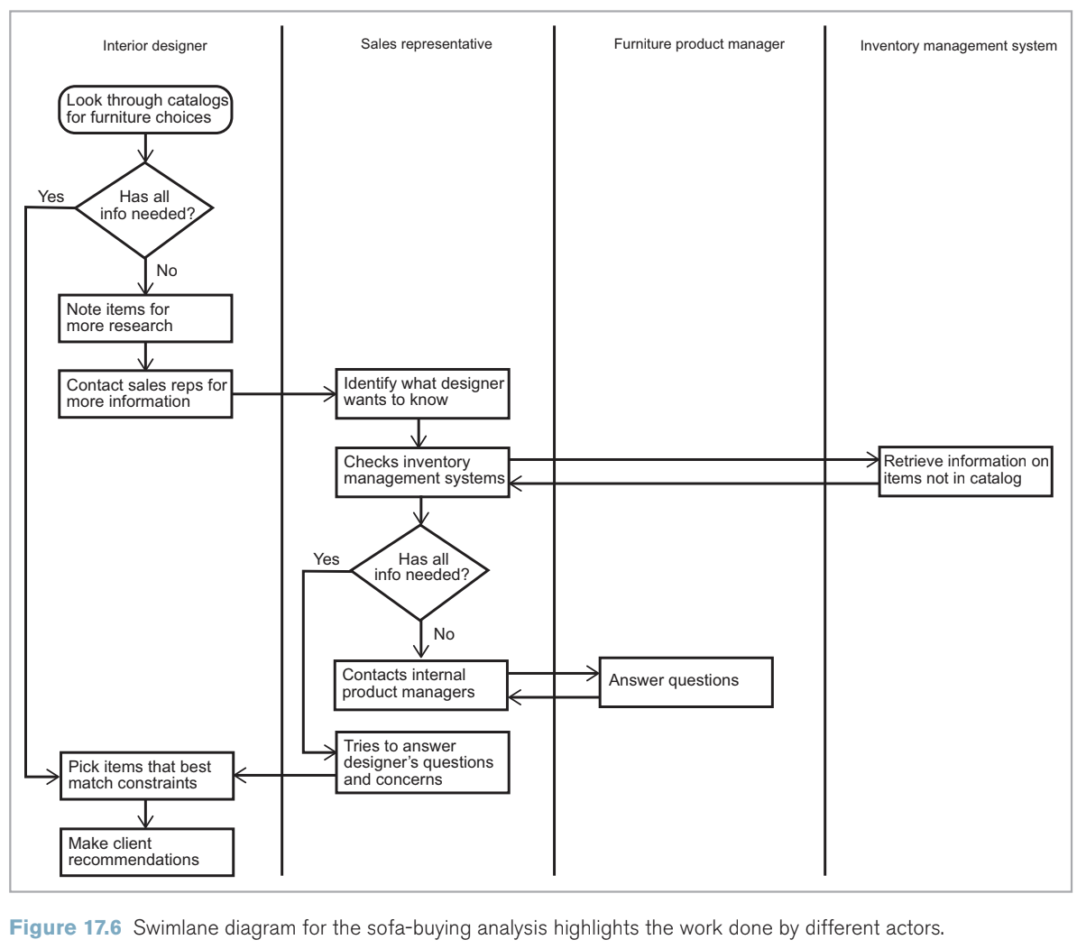
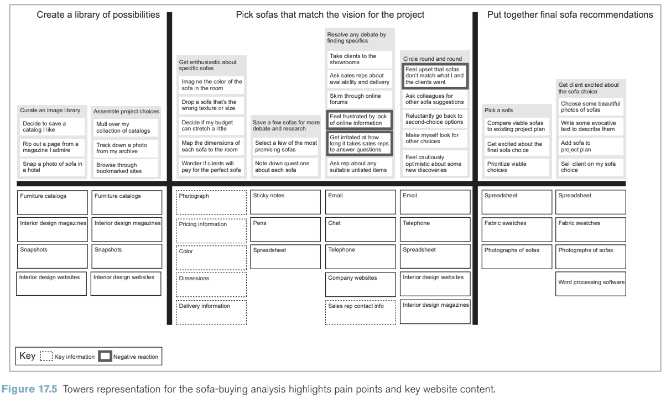
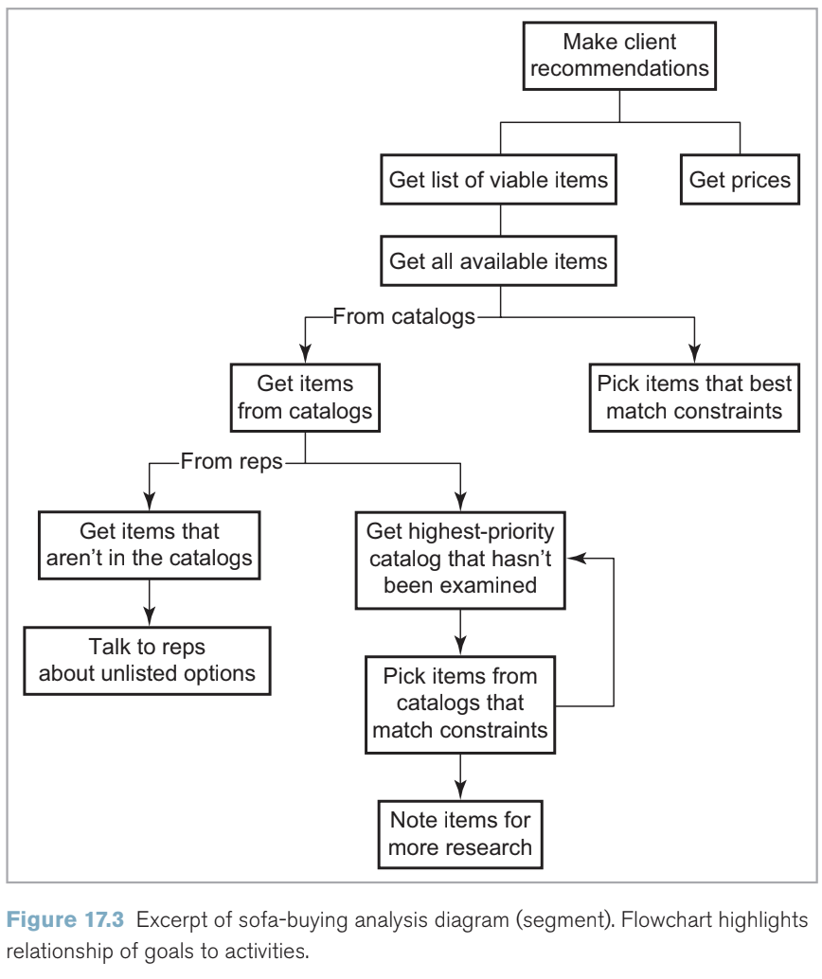
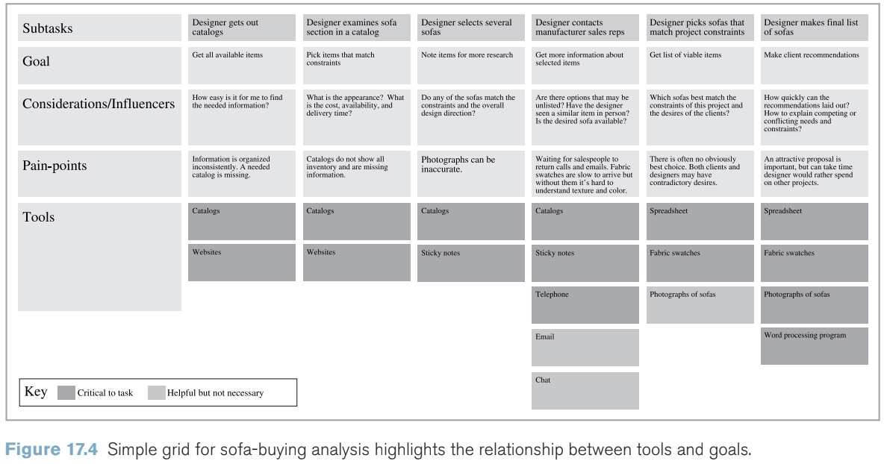
Representing Activities and Processes
Notes:
Representing tasks
Flowchart diagrams
work especially well as overviews of complex activities with multiple decision points and outcomes
difficult to include any explanation of each individual step beyond its name and outcome.
Important dimensions such as a task’s purpose, cues, and objects can get lost.
Grids
emphasize the linear nature of tasks by representing each step as a box on a horizontal line. Below each step, however, there is now a stack of information about its purpose, triggers, resources, etc.
Towers
do not necessarily represent linear steps in a process
Represent different options for action along the way and how people feel about them
tools for seeing the intersection between what people want to do and the resources available to them
In a tower diagram, each major section represents a high-level goal, laid out in chronological order from left to right. Thick vertical lines divide the goals. Within those major sections are towers of boxes, which represent conceptual groups of tasks. There’s a horizontal line below the towers of tasks that represents the line between the user’s experience and the tools, content, or features that support it. Each tool, content, or feature gets a box of its own.
Towers make gaps or negative experiences in tools (as for a workflow), content (as for a website), and functionality (for software) immediately visible.
Maps
Task analysis typically follows individuals. If you are surveying activities that involve multiple people, systems, or businesses, process mapping is a better choice.
Unlike scenarios and task analyses, process maps incorporate not just the experience of a user but also the system activities and business processes necessary to support it.
Process mapping has come to prominence in support of service design for activities such as banking that rely on multiple touchpoints, or opportunities for use.
A swimlane diagram does just what you think: it visually distinguishes the tasks required of different actors by dividing them into separate “lanes.”
emphasize how different actors must cooperate to accomplish a process. As such, they represent processes and tools that may be invisible to the user or customer.

Slide 11
Representing Systems: Experience Models
What are Experience models?
Visual representations to help researchers understand user interactions of a product or system
Helps researchers understand intricate user experiences by providing comprehensive view of user’s needs in a system
Identifies opportunities for improvement and provides holistic view of user experiences
How to create an Experience Model?
Diagrams, Flowcharts, Storyboards
Model represents the user’s journey through the product
Reflects the user’s experience precisely based on research findings
Defines user’s journey through visual representation
Notes:
Experience models are visual representations of how users interact with a product or system over time. They can help communicate complex interactions and experiences that cannot be easily explained in words alone.
They are a powerful tool for researchers to better understand the user's journey and identify areas for improvement in the system or product being studied. By using experience models, researchers can supplement traditional written summaries and make it easier for stakeholders to act on research insights. Experience models are especially useful when a product or system is complex or has many different components that interact with one another.
Now that we've covered what experience models are, let's talk about how to create them. After conducting research, researchers can use various design tools, such as diagrams, flowcharts, or storyboards to create experience models.
The model should represent the user's journey through the system or product being studied over time. It should be based on research findings and accurately reflect the user's experience. Experience models can be used to identify pain points, opportunities for improvement, and areas where users may need additional support. Researchers should pay attention to the details of the user's journey and capture any potential pain points, moments of delight, or opportunities for improvement.
Creating an experience model is not a one-time task; it should be an iterative process that incorporates new insights and updates based on ongoing research. Researchers should also consider using multiple types of experience models to capture different aspects of the user journey and to communicate their findings to different stakeholders. For example, a flowchart might be useful for showing the sequence of actions a user takes in a system, while a storyboard might be more effective for capturing the emotional journey of the user.
When creating an experience model, researchers should also consider the context in which the user is interacting with the product or system. This might include factors such as the user's goals, the device or platform being used, and the user's environment.

Slide 12
Representing Systems: Experience Models
Sharing an Experience Model:
Allows individuals or teams to transfer knowledge and expertise to others
Allows stakeholders to know development approach of the model and the research findings
Ensures researchers that design decisions are made with consideration of user needs
Notes:
Sharing an Experience Model Once the experience model has been created, it's important to share it with stakeholders. Experience models enable the sharing of specialized knowledge and expertise, which helps to increase the overall capabilities of individuals or teams.
Researchers should introduce the experience model to stakeholders in person and walk them through it section by section. By sharing experience models with stakeholders, researchers can help ensure that research insights are acted upon and that design decisions are informed by user needs. Experience models can be used to facilitate discussions and decision-making around product or system design, and can serve as a useful reference for design and development teams.
Experience models can also be used to train new team members on how the product or system works and what the user experience is like. Researchers should be prepared to answer questions from stakeholders and to provide additional context as needed. It's also important to keep the experience model up-to-date as the product or system evolves over time.

Slide 13
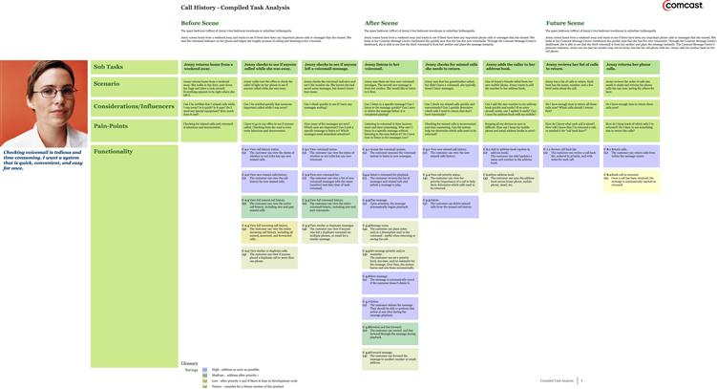
Putting it all together
No need to keep different types of representations separate
Notes:
Designing tools means understanding people’s goals and the exact steps they take to accomplish them
How critical is a task to accomplishing the goal? How often is it performed? What is the order of actions? What are the tools involved? Where do problems typically occur? Where is there flexibility in the process? What decisions must be made, and who makes them? What kinds of resources, informational and otherwise, do people need and use at various points in the process?
Task analysis
Personas portray characters, and scenarios tell stories. In contrast, a task analysis details sequences of actions taken by an individual person.
best used when you already know what problem you’re trying to solve but you don’t know how people are solving it right now
It can help diagnose potential usability pain points, establish system dependencies, or identify new product development opportunities in areas where people lack the tools they need to accomplish their goals.
Task analysis is also best used for goal-directed, well-bounded procedures, such as buying furniture.
Activities with no clear criteria for success and no defined sequences of steps are not likely to be amenable to decomposition.
qualitative methods such as interviews and field visits; combination since participants are more likely to tell you how a task is supposed to be done rather than what they are actually doing
Using stakeholder interviews (described in Chapter 4), decide how detailed your task analysis needs to be to support the needs of design and development through the next major product development cycle. It can be helpful to create a template or example ahead of time to help you figure out when you’ve provided enough detail.
Questions at these interviews should be geared toward understanding how the participant performs the task at hand.
Analyzing the data
Task decomposition
Describe the actions and do error projection to see what would happen if the action weren’t performed
Hierarchical task analysis
HTA maps out the relationships between steps by putting them into groups, then indicating how the individual steps and groups are connected.
Resembles a flowchart
If you’re mostly interested in how the components of a task fit together (for example, if you’re looking for where a tool can optimize a task’s speed), then start with HTA and flesh out key details with decomposition. If you’re interested in making a tool that fits with existing practice, then start with decomposition as a way to understand inputs and outputs, and then quickly sketch out the progress of the task in hierarchical form.
Representing tasks
Flowchart diagrams
Grids
Towers
Maps

Slide 14
A Final Warning
Research diagrams or models are means to an end, not the ultimate goal
Requesting personas or scenarios without clear objectives or defaulting to task analyses without considering project objectives can hinder research outcomes
Researchers should choose research activities that align with project objectives and negotiate with stakeholders for alternative outcomes if necessary
The focus should be on delivering research outcomes that genuinely benefit the project
Notes:
Research diagrams or models are essential tools that help researchers to understand complex systems and processes. However, it's important to remember that these are means to an end, not the ultimate goal. It's easy to get caught up in the creation of these models, and forget the bigger picture.
Requesting personas or scenarios without clear objectives, or defaulting to task analyses without considering project objectives can hinder research outcomes. Researchers should carefully consider the needs of their stakeholders and align research activities with project objectives.
It's also important to negotiate with stakeholders for alternative outcomes if necessary. Sometimes, stakeholders may request specific research outputs without considering their true value. In such cases, researchers should suggest alternative outcomes that will better serve project goals.

Slide 15
PERSONA NON GRATA?
Enthusiasts believe personas are indispensable in conceptualizing user differences and underwrite empathy-driven design, while also being a simple way to unify teams.
Doubters believe personas oversimplify complex behaviors into worn clichés and encourage design teams to make decisions based on personal interpretations of fictional characters rather than real users.
Tips for Using Personas Effectively
Build characters, not stereotypes, to avoid negative associations and create empathy.
Connect personas to action by rewriting them around needs and using them to guide design brainstorming.
Don't let personas stand alone; use them alongside other research deliverables to convey a range of design insights.

Slide 16
Informal Reporting
What to Communicate?
How you generated results
What is most important
What’s next
How to Communicate?
Email
Verbal
Blog
Wiki
When (ie. How Often)?
Weekly, usually
For reference, 24/7
Why?
Quickly assist decision makers
Engage the clients in process
Influence direction of research
Get client invested in results

Slide 17

Preparing and Presenting Formal Reports
Types of User Research Reports:
Usability Reports
Documentaries
Design Springboards
How to Prepare:
Know your Audience
Know your Process
Photo credit: Robert H. Smith School of Business

Slide 18

Preparing and Presenting Formal Reports
Creating Formal Reports:
Executive Summary
Procedures/Methods
Recruiting
Data Collection
Analysis
Limits
Participant Profiles
Main Themes
Research Outcomes
Conclusions
Appendices
Photo credit: Dieter Holstein (https://stock.adobe.com/contributor/211113528/dieter-holstein?load_type=author&prev_url=detail)

Slide 19

REMEMBER!
Test report style against user expectations BEFORE delivering it!
Never save the best for last, this is not a novel!
Photo credit: M. Dykstra (https://stock.adobe.com/contributor/200746816/m-dykstra?load_type=author&prev_url=detail)

Slide 20
Making a Presentation
What makes a successful presentation?
Present the all critical information, but tailor it to appeal to you audience.
They may not know technical terminology for your product, so use this sparingly, and define these terms when used.
Make sure to leave time for questions, as they will inevitably arise.
Many presentations involving user experience are hard to adequately cover with just words, so prepare physical demonstrations!
When using videos, use only short clips to help retain the audience's attention, and label the clips so they understand what they are watching.
Presentation Title

Slide 21
Problems in Presentations
What to look out for when making a presentation
Be careful with what you say, try to focus on your product and not the company itself.
Audience members may challenge certain findings
If they say that a studied group isn’t part of the products target audience, use this to explain how your target audience may be wider than originally thought
If someone questions the ability of a user, remind them that the studied group was selected based on agreed upon criteria which group members met.

Slide 22
The Workshop
Workshops are great for helping to solve complex problems
Usually take place after presentations to help dissect findings and apply it to the product and company.
To ensure workshops are productive, ensure goals are laid out at the start
However, you should also inform all participants to keep their expectations realistic. A workshop session does not guarantee a big breakthrough
Make sure that data is at the heart of discussions, as otherwise personal preference and opinions may begin to warp the takeaways of the workshop
There is no one “correct” way to hold a workshop, try experimenting and see what works best for your group and product

Slide 23



Extending the Reach of Research
What happens after the presentation?
Researchers can:
Keep working with product teams
Work as consultants
… but they have fewer opportunities to impact decision making
Strategies for providing ongoing support:
Augment deliverables: handing over project archives to help answer later questions
Encourage research ownership: involving clients in research analytics and findings
Follow up: checking with clients how they’re using the information

Slide 24
Conclusion
Anticipate people’s needs and work with them to find solutions is the best way to overcome their doubts
Preparation is key in knowing your audience

Slide 25

Making Connections….
Between Goodman Ch.17 & 18…
Personas can be used to help prepare audiences for reports and presentations
They can act as a quick guide/reference as to target audiences for your product
The nicknames personas can be given can act as a way to provide a “physical” person for people to think about when imagining scenarios in the user experience.

Slide 26

Making Connections…Pt.2
Connections Between Goodman Ch.17 and Travis & Hodgson Ch.2…
The idea of personas matches with how Travis & Hodgson suggest one recruits for User Experience Research
Travis & Hodgson recommend using behaviors, and ignoring demographics
Persona’s can be created using usage data, which would be based on behaviors over demographics

Slide 27

Making Connections…Pt.3
Connection Between Goodman Ch.18 and Travis & Hodgson Ch.4…
At the start of Travis & Hodgson Ch.4, the authors emphasize the importance of focusing on objective observations
This is similar to how Goodman suggests keeping workshops on track by encouraging members to focus on data, not opinions/personal feeling
Both authors suggest using hard data from a research study as this builds a more reliable base for which to work off of on identifying problems and solutions in the user experience.

Slide 28

Questions for Discussion
As stated in Chapter 17, the use of Personas can be controversial. Some people find them incredibly helpful, while others argue they put users into overly simplistic categories and can sometimes lead to unintended consequences such as stereotyping. What is your position on this, and how do you think one could avoid the pitfalls should they choose (or be forced) to utilize personas in their user experience research?
For both reports and presentations, it is key to understand the audience and tailor it for them. How should one go about figuring out who their audience is, and how much should they change their report/presentation so as to tailor it for them without losing key details?

